Slide 1
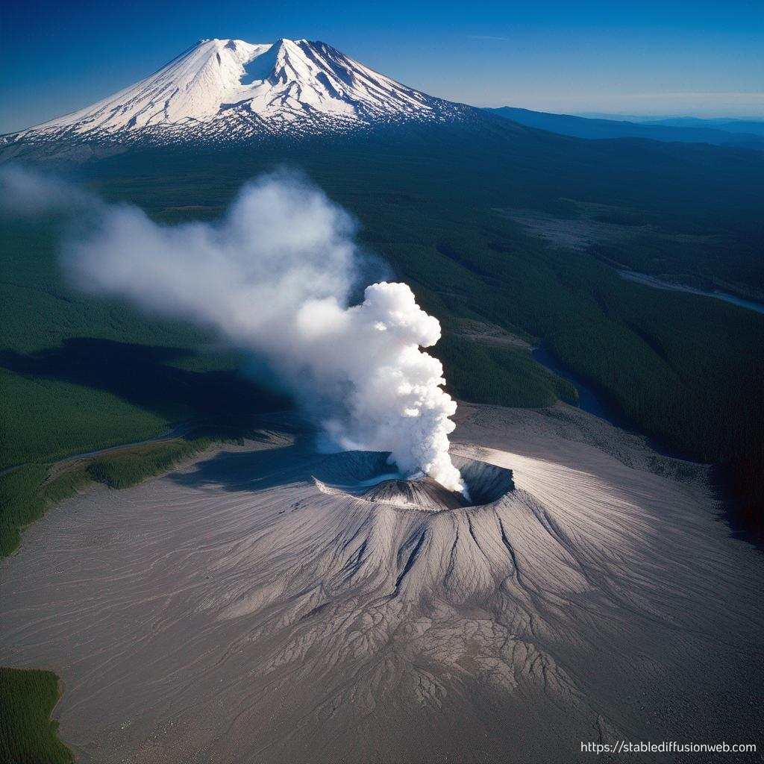
SeismoMech
Yash Bhangale, Shreeya Gadgil,
Manuela Köpfli, Callum Keddie,
Guiliang Zheng
12/12/2023

Slide 2
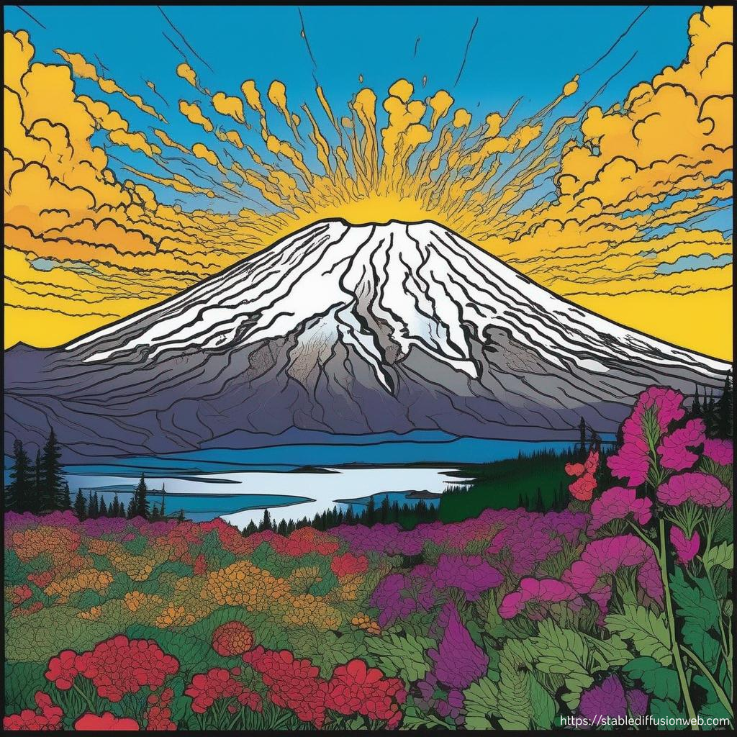
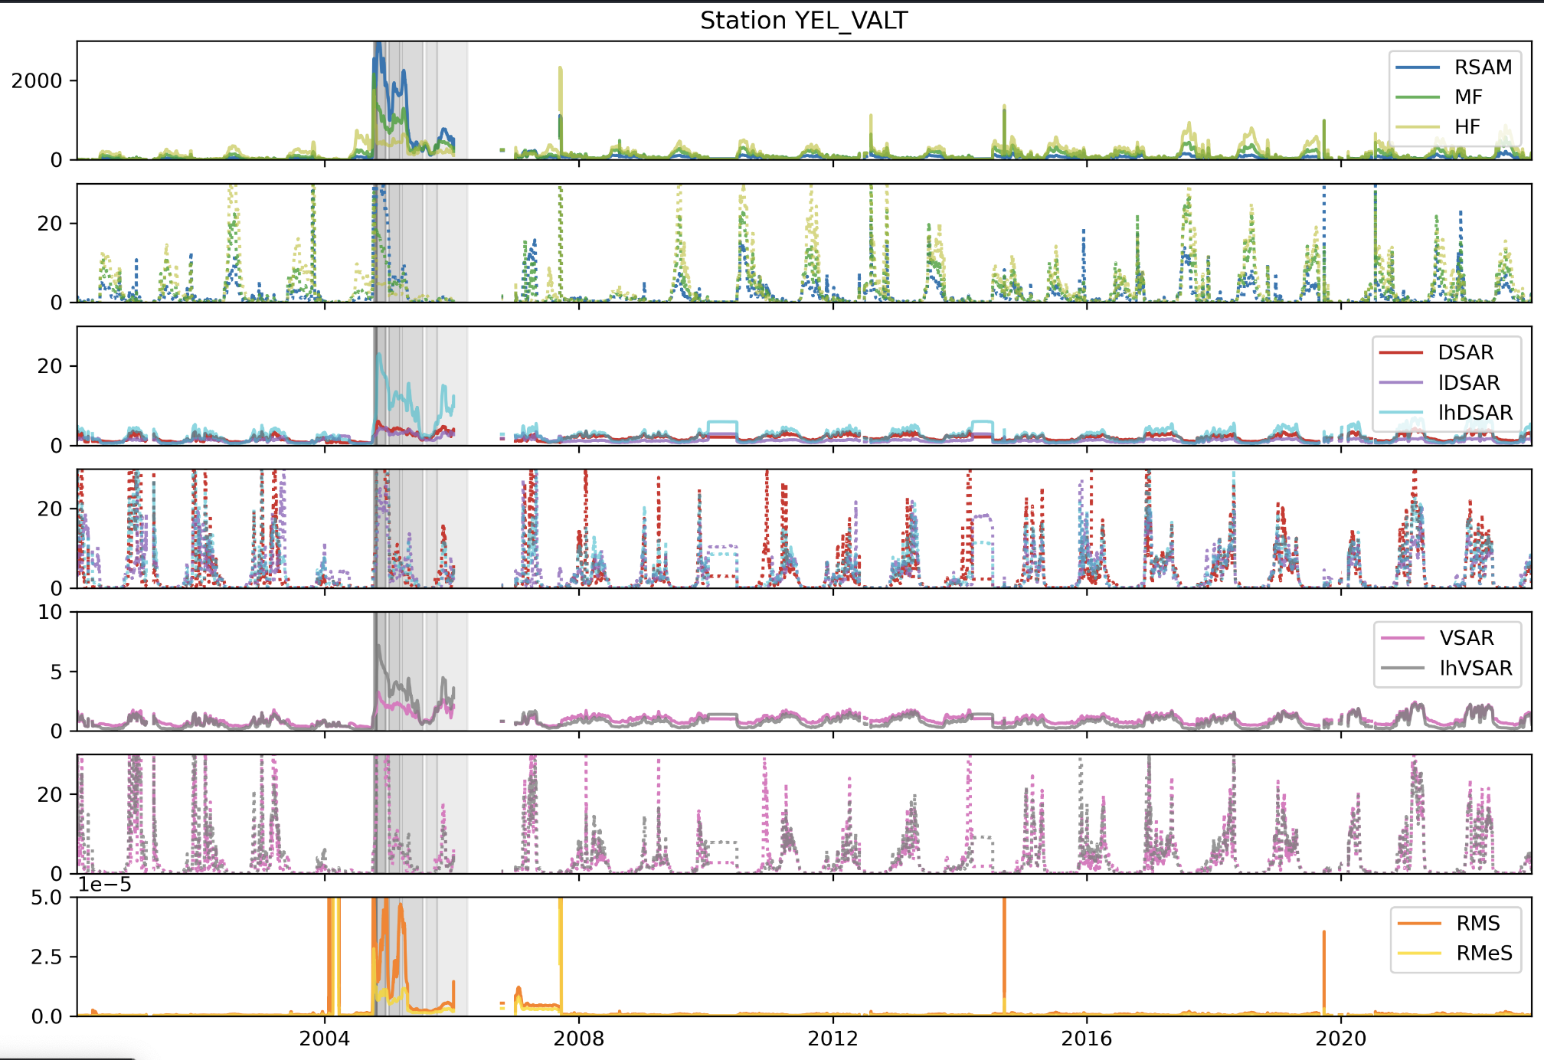
Background & Data
Mount St.Helens: Eruption from 2004 to 2008.
Multiple domes formed within the crater in this four years (Image data)
Seismic network data over 22 years
RSAM: Real-Time Seismic Amplitude
DSAR: Displacement Seismic Amplitude Ratio
Notes:
Mount St. Helens, located in the Cascade Range, is a volcano with a significant eruption history. The most recent eruption was from 2004 and this eruption lasted for 4 years, over the 4 years, we have seen increased seismic activities. We have also seen multiple magma domes formed within the crater during the eruption(figure below, gray period). The seismologist have estimated the dome extrusion rate using image data. On the other hand, extensive seismic data was also collected from the seismic network over 22 years, which provide insights into long-term underground changes. Those two types of data will serve as the two main data source of our project, or analyzing seismic activities and volcano eruption in general.

Slide 3
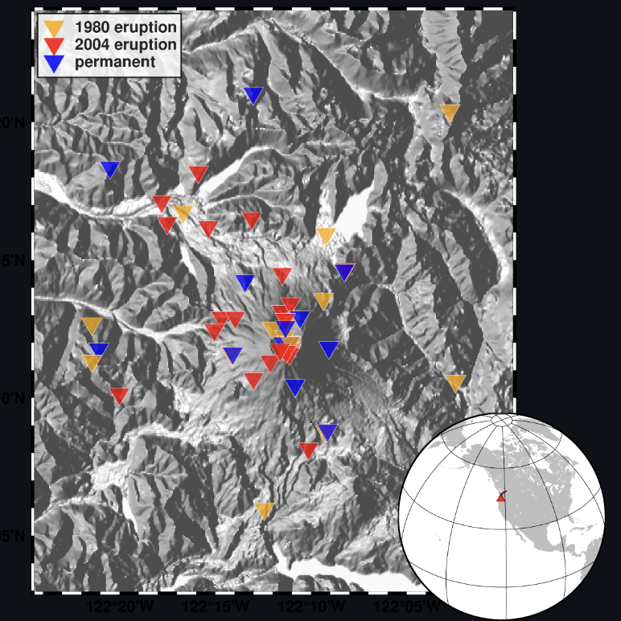
Project Goal
The correlation of seismic attenuation and volcanic magma extrusion rate.
Analysis of Changing Climatic Patterns.
Notes:
So our project goal is to find the correlations between the seismic data and the things that seismologist might be interested in. In this project we are mainly focus on two thing, the volcanic magma extrusion rate, and the change of the climatic pattern in the region.
While It’s intuitive that there’s some correlations btw attenuation and the magma extrusion, we also need to remove the seasonality effect from seismic attenuation data by stack the data in years to mitigate unwanted correlations.
When analysing changing climatic patterns in the region, because local whether effects often dominate the data, in oder to mitigate this, data is spatially stacked, involving averaging all seismic data over all seismic stations over the region for a given year.

Slide 4
Use Cases
Correlation analysis for volcanic activity
Users can find correlation between seismic attenuation and magma extrusion rates
Seasonal pattern analysis
Users can distinguish between natural seasonal influences (e.g., heavy rainfall, snowfall, volcanic activity).
Regional variation analysis
Users can explore subpatterns within the region, comparing seismic data between different areas (e.g., crater region vs. lake area)

Slide 5
Users
Seismologists:
Other seismologists may study the data at different locations around the world and want to apply the same analysis.
Environmental Scientists:
Interested in how seismic events affects seasonal trends
Geologists:
Interested in geological processes affected by seismic events

Slide 6
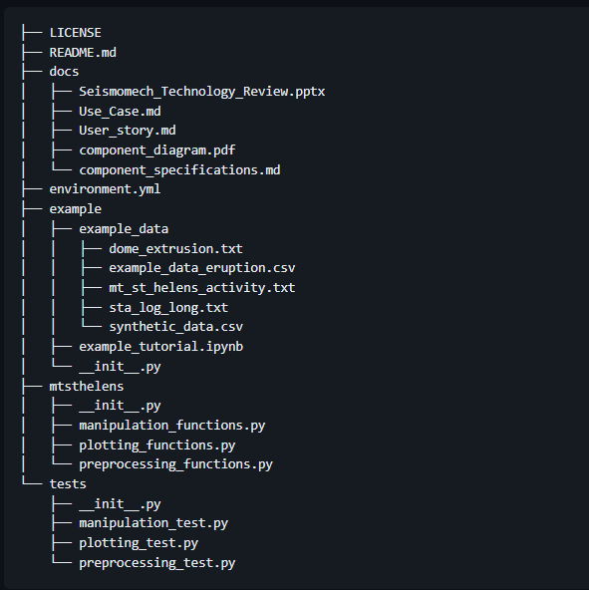
Software Design
Scripts are divided in 3 categories: Preprocessing, Manipulation and Plotting
The Flow goes in the order: Preprocessing > Manipulation > Plotting
Modular and Scalable code.
Use of Environment for PyGMT
Software Structure
Code is structured in 3 .py files, contains multiple functions
Tests are structured in 3 .py files, each corresponding to the main code files.
Notes:
The software is divided into 3 parts: Preprocessing Functions, Manipulation Functions and Plotting Functions. All the scripts contain multiple functions that help preprocess, manipulate and plot different attributes of the data.
The data flow starts with the preprocessing, moves onto manipulation, and then plotting.
The code is broken in parts for easier maintenance, changeability, and can be scaled to perform on larger datasets.
We use an environment for using PyGMT, the software that helps us make maps.

Slide 7
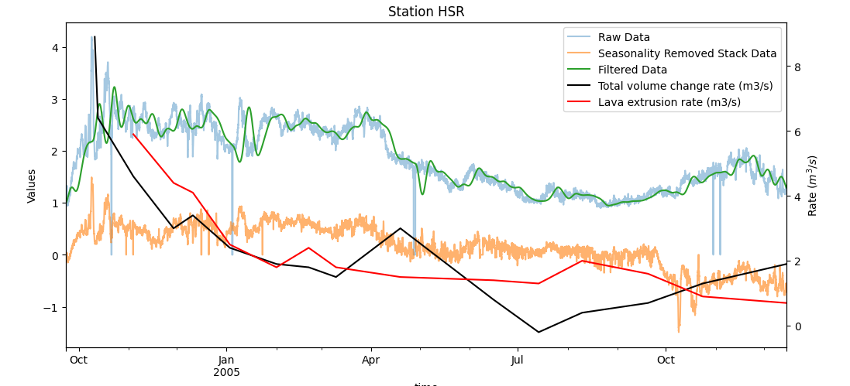
Example tutorial
Uses a subset of the main data
Outlines the main functionalities, commands, or actions users can perform.
Location : example/ example_tutorial.ipynb

Slide 8
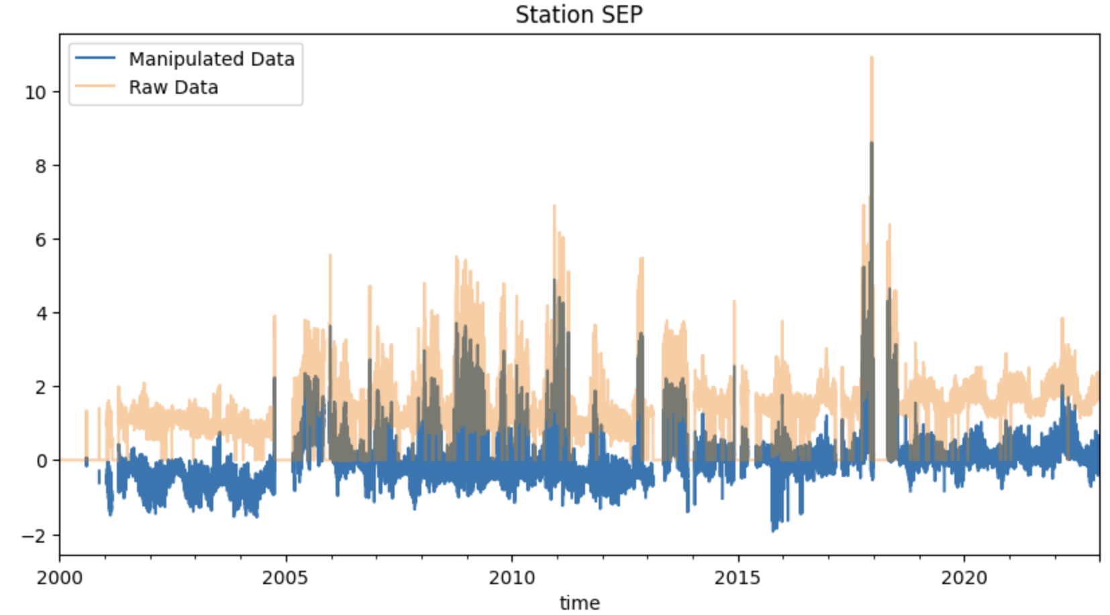
Data Manipulation Results
Stacking
Removes offset
Removes seasonality after eruption
Adds seasonality before eruption

Slide 9
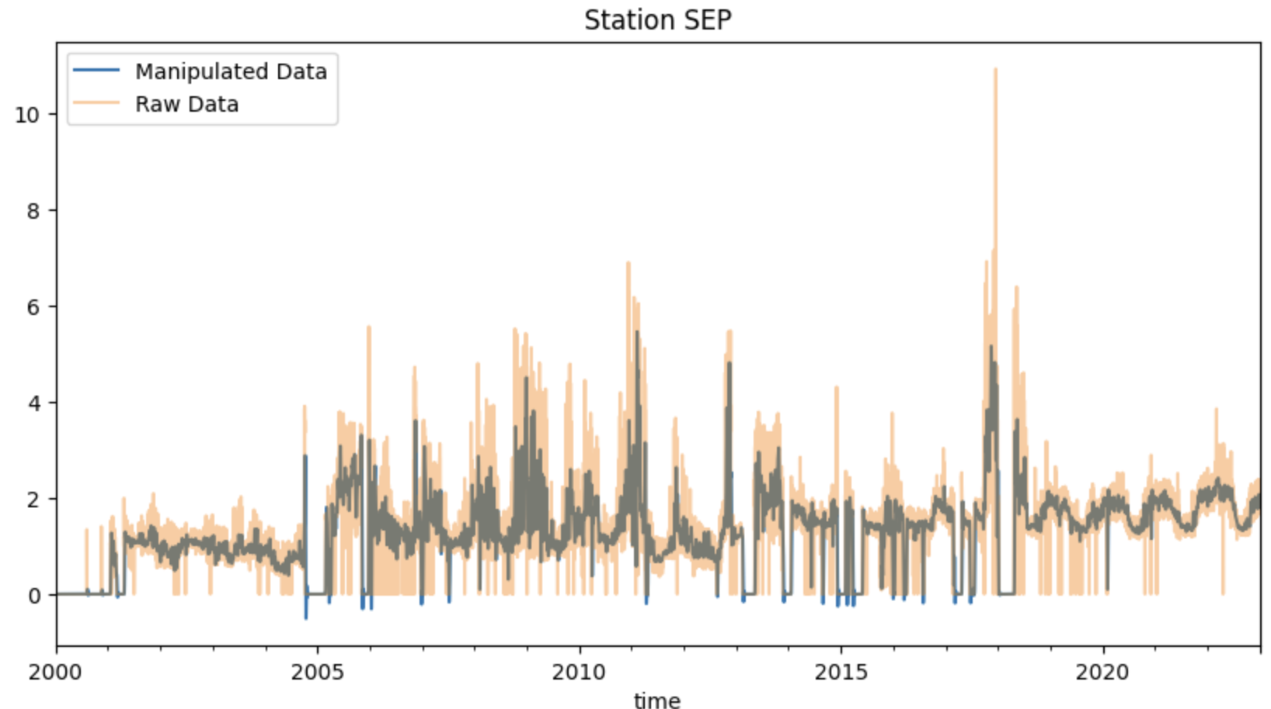
Data Manipulation Results
Stacking
Removes offset
Removes seasonality after eruption
Adds seasonality before eruption
Filtering
Removes outliers but seasonality more prone
Removes seasonality but outliers more prone

Slide 10
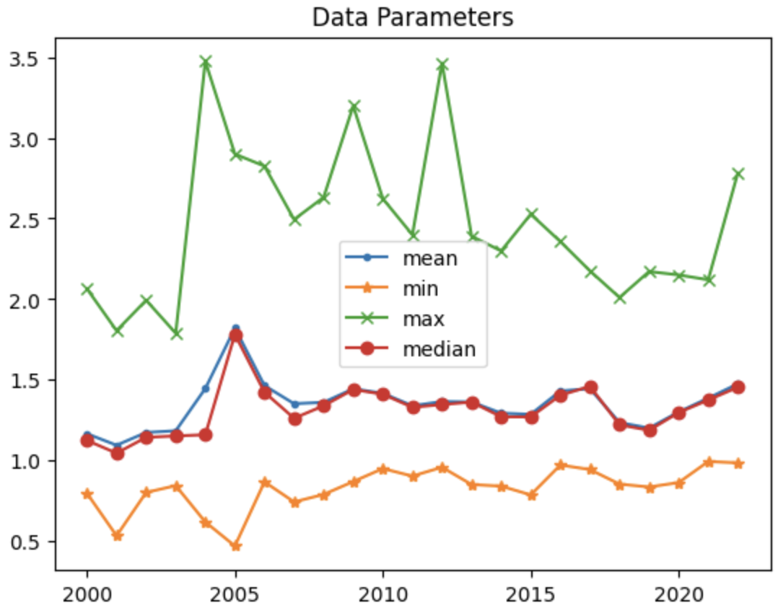
Some Scientific Interpretations
Eruption clearly visible
Increasing attenuation over 22 years

Slide 11
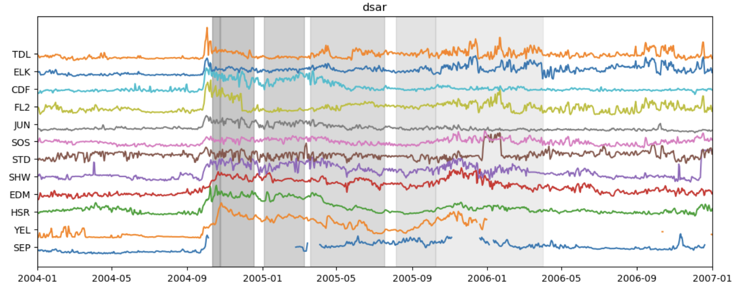
Further Work
Finish a plot of all stations in one sorted by distance
We have
Function to sort by distance
Function to normalize each station
We need
Plotting function
Apply for other parameters
Applied to
DSAR
Other parameters
RSAM, VSAR, zsc-normalized parameters, RMS, PGV,...

